Slide 1

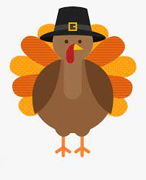
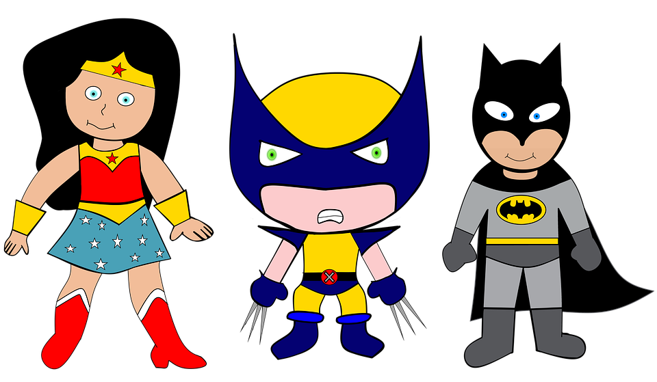

We are SUPERheroes!
Students Using their Powers to Engage in Reading!
Kindergarten Newsletter – November 15-19, 2021
IMPORTANT EVENTS
Breakfast ends at 7:25!
11/16 11/17 11/18 11/19 | C hall Field Trip Holiday Pictures (dress up) Farm Day (dress up) B hall Field Trip
The EXPERT in anything was once a BEGINNER!
HOMEWORK
Mon. – Thurs. | Weekly ELA Sheet Math HW Pages Practice Sight Words List Read 10 minutes per night
WEEKLY ASSESSMENTS
ELA | Module 4.1 test Initial Sounds Test Spelling Test (cap,pat, tap)
Math
SCHOOL NEWS
Enjoy your Thanksgiving Break! No school November 22-26
WEEKLY MATH SKILLS
2D shapes/Positional words Writing 1,2,3,4,5,6,7,8,9,10 More and Less Decompose numbers 3-10
REMINDERS
Please make sure all money is sent in your child’s blue folder labeled and sealed. If your child is absent, please send an excuse labeled with the following information: Child’s name, date of absence, teacher’s name, and reason for absence.
SCHOOL SAFETY
Be sure your child wears a mask to school DAILY!

Slide 2
Module 4 Week 1: Happy Healthy Me!
LEARNING MINDSET: Setting Goals
ESSENTIAL QUESTION
How can I be my healthiest self?
PHONICS
Introduce Letters: Gg and Kk - ig word family
READING
Genre: Fiction Story Elements: Characters, Settings, Events Informational Texts | Listening Comprehension Parts of a Book Collaborative discussions
WORDS TO KNOW
Big Good His very
VOCABULARY
BIG IDEA WORDS: energy, exercise, healthy POWER WORDS: active, stretch, weight Books: Being Fit and Germs Are Not For Sharing
REVIEW
Letters and sounds Aa-Ff Gg-Pp Qq-Zz
WRITING
Nouns and Verbs Characters/Setting Narratives
SPELLING WORDS
Tap Pat Cap
PHONEMIC AWARENESS
Identify Rhymes Identify Syllables Beg., Medial, Final Sounds

